Slide 1
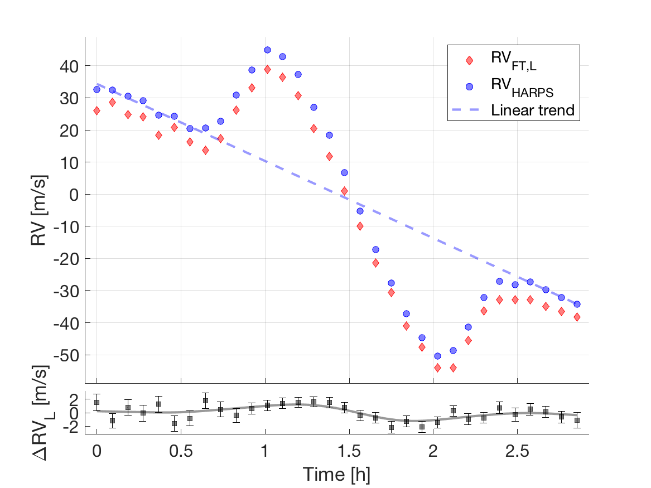
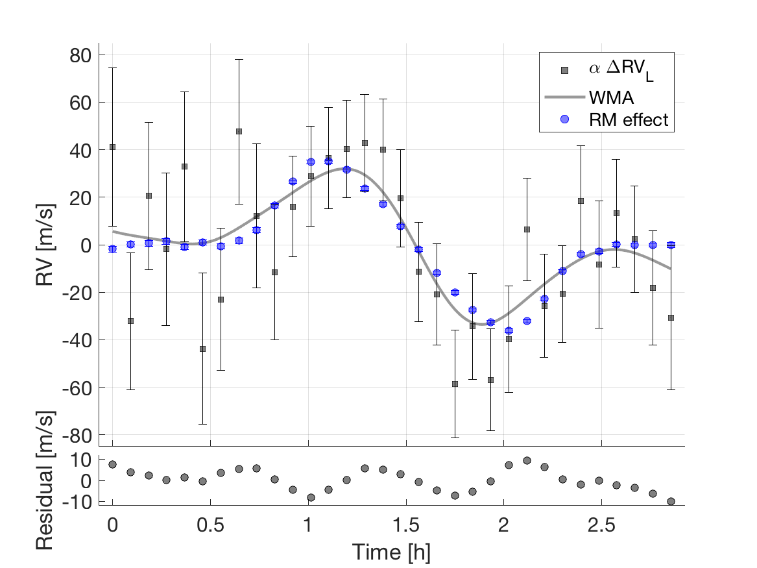

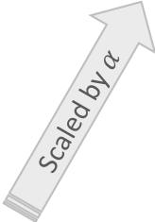

HD189733: Rossiter–McLaughlin effect as jitter
Linear trend removed
$∆$RV_{L}$=$ RV_{HARPS} $−$RV_{FT ,L}
Residual = WMA $−$ RM effect
Scaled by $α$

